Slide 1
Prosody in spontaneous speech:
Automated approaches
David Lukeš
Czech Language Institute, Czech Academy of Sciences
3rd International Conference on Sociolinguistics

Slide 2
Overview
Recent spoken Czech corpora at the Czech National Corpus
Case study: pitch range in spoken Czech
Automatic prosody annotation: tools and approaches

Slide 3
Recent spoken Czech corpora
At the Czech National Corpus

Slide 4
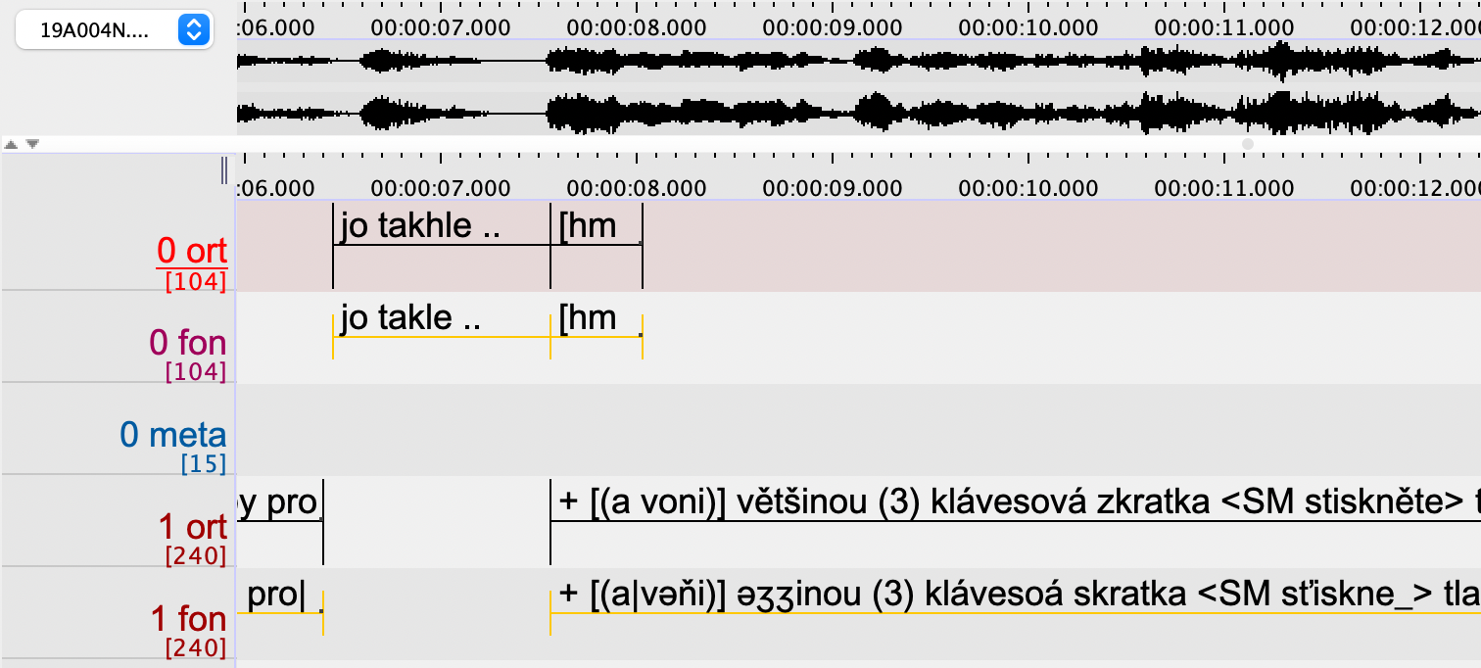
ORTOFON corpus: “dialogues” https://wiki.korpus.cz/doku.php/en:cnk:ortofon

Slide 5
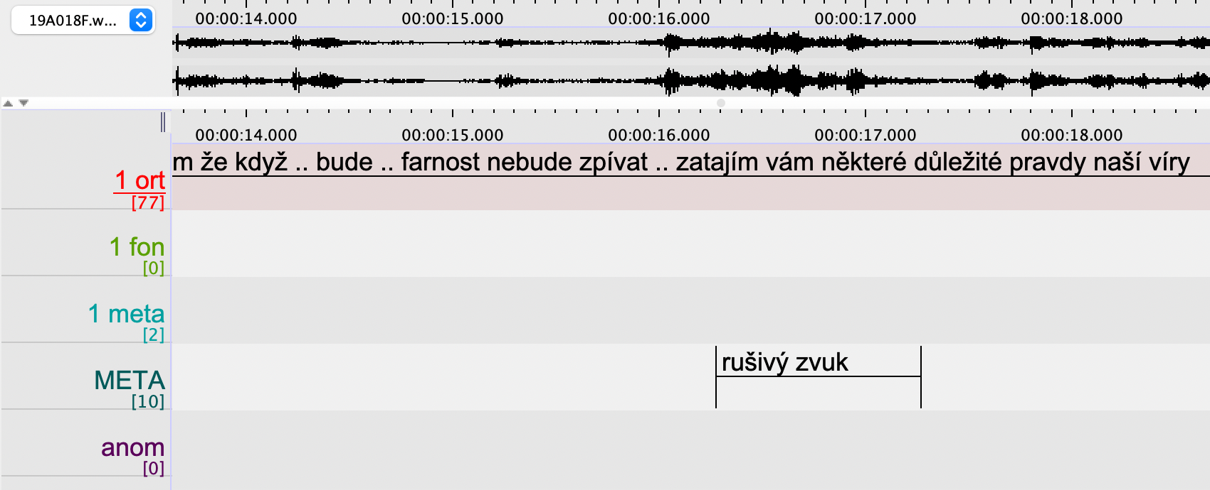
ORATOR corpus: “monologues” https://wiki.korpus.cz/doku.php/en:cnk:orator

Slide 6
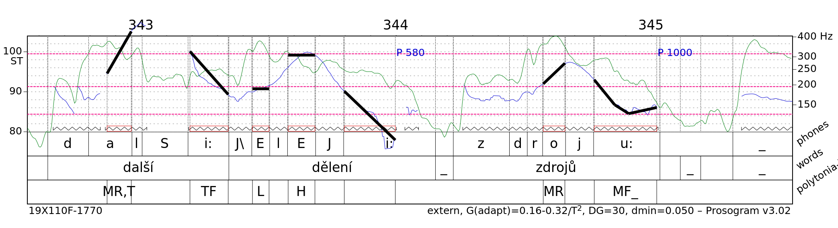
Prosogram of an ORATOR v2 sample https://sites.google.com/site/prosogram

Slide 7
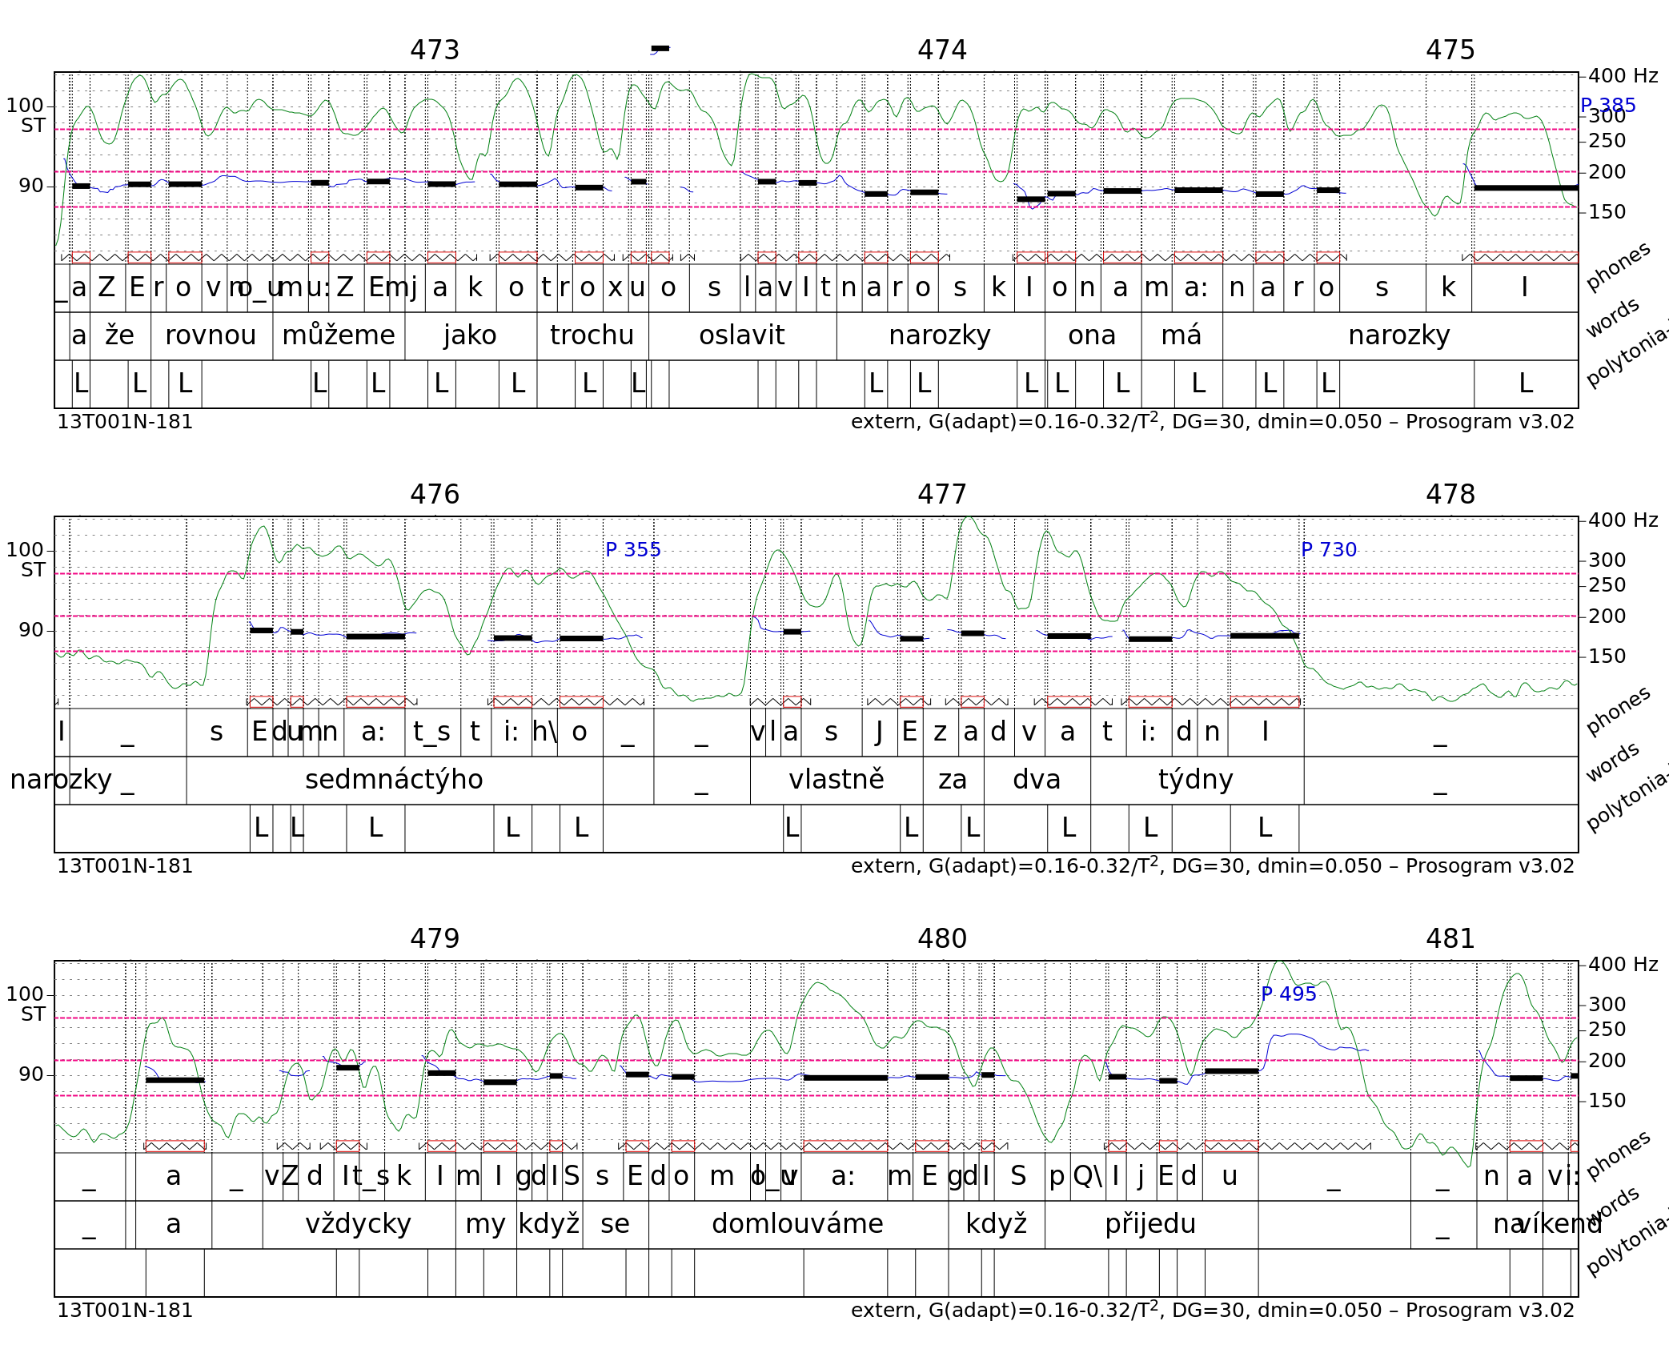
Prosogram of an ORTOFON v2 sample

Slide 8
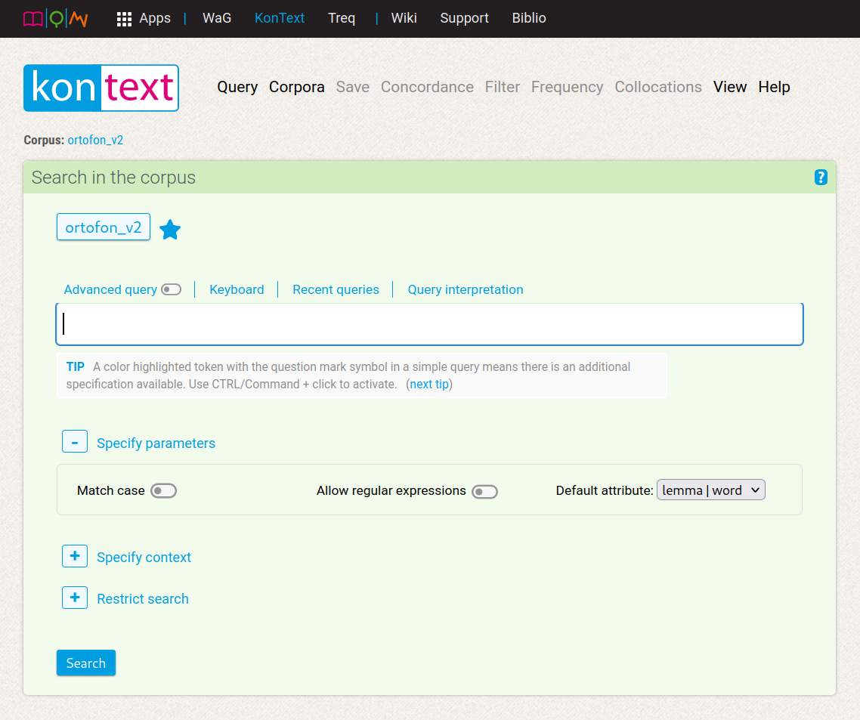
Using prosody for search https://www.korpus.cz/kontext/query?corpname=ortofon_v2

Slide 9
Pitch range in spoken Czech
A case study

Slide 10
Why so dull?
As evidenced e.g. by comparison of pitch ranges in Czech, English, and Czech-accented English (Volín et al. 2015)
Speech (sub-)communities can differ in the pitch profiles they favor (Dolson 1994)
Fixed (vs. lexical) stress: No acoustic correlates (Skarnitzl 2018)
Free (vs. fixed) word order and topic-focus articulation
  Alice gave the apple to Bob. Alice dala jablko Bobovi.
  Alice gave the apple to Bob. Alice dala Bobovi jablko.
  Alice gave the apple to Bob. Jablko dala Bobovi Alice.

Slide 11
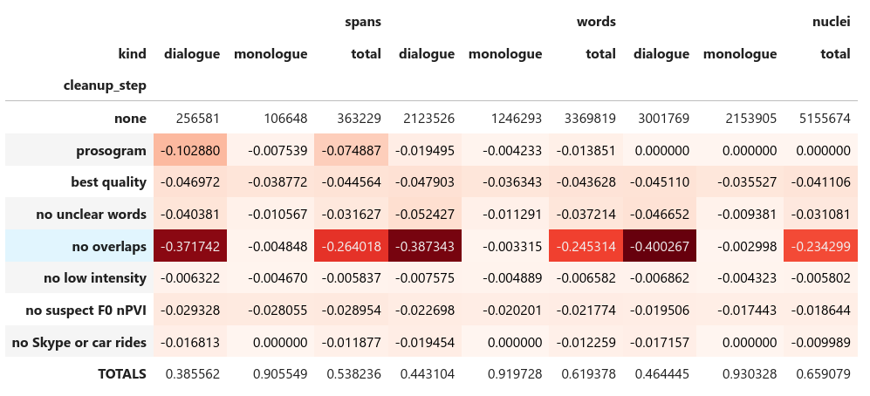
Data and cleanup

Slide 12
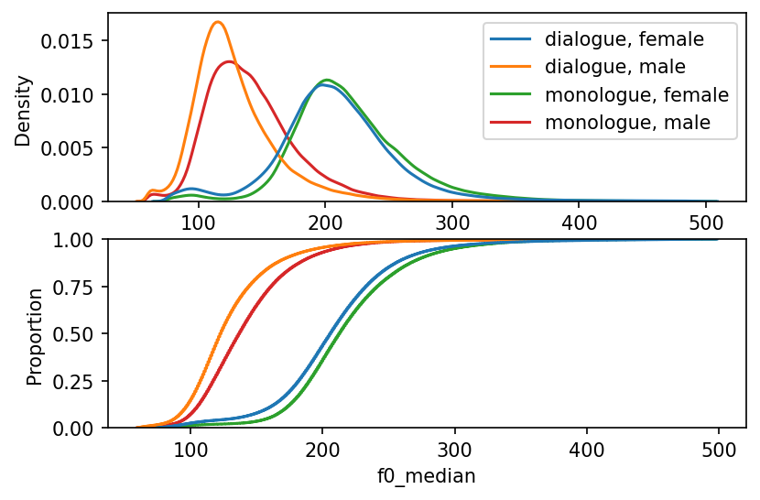
Sanity check: Full data

Slide 13
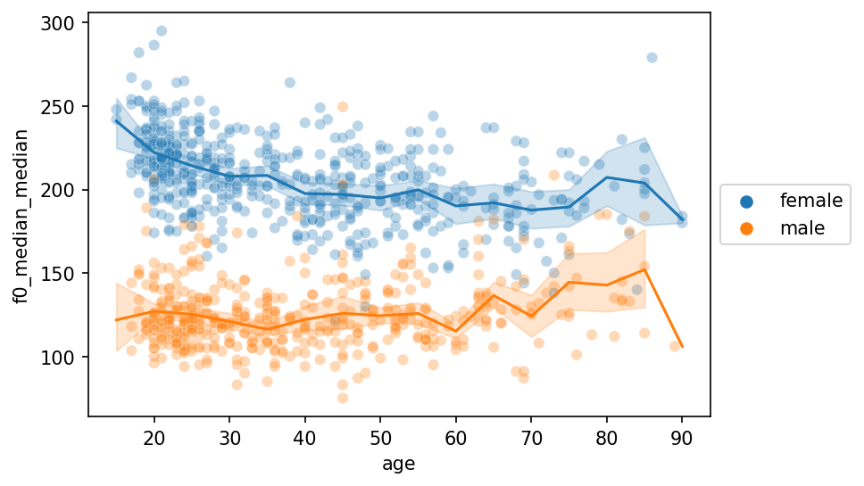
Sanity check: Dialogue only

Slide 14
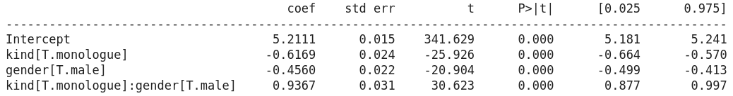
Linear model: Full dataset
Ordinary least squares regression model of pitch range ~ kind + gender in the full data set.

Slide 15
Linear model: Full dataset
gender ↓ kind → | Czech dialogue | Czech monologue | Czech read | BrE read
female | 5.21 | 4.59 | 5.2 | 7.1
male | 4.76 | 5.07 | 6.1 | 8.1
Predicted pitch range values in ST for various combinations of the kind and gender factors. Where kind is Czech monologue or dialogue, this is based on data from this study; where kind is Czech read or BrE read, the data comes from Volín et al. (2015).

Slide 16
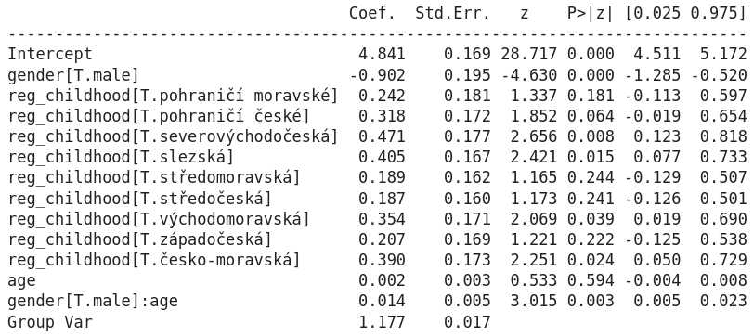
Linear model: Dialogues
Mixed effects model of pitch range ~ gender * age + reg_childhood in the dialogue subset of the data.

Slide 17
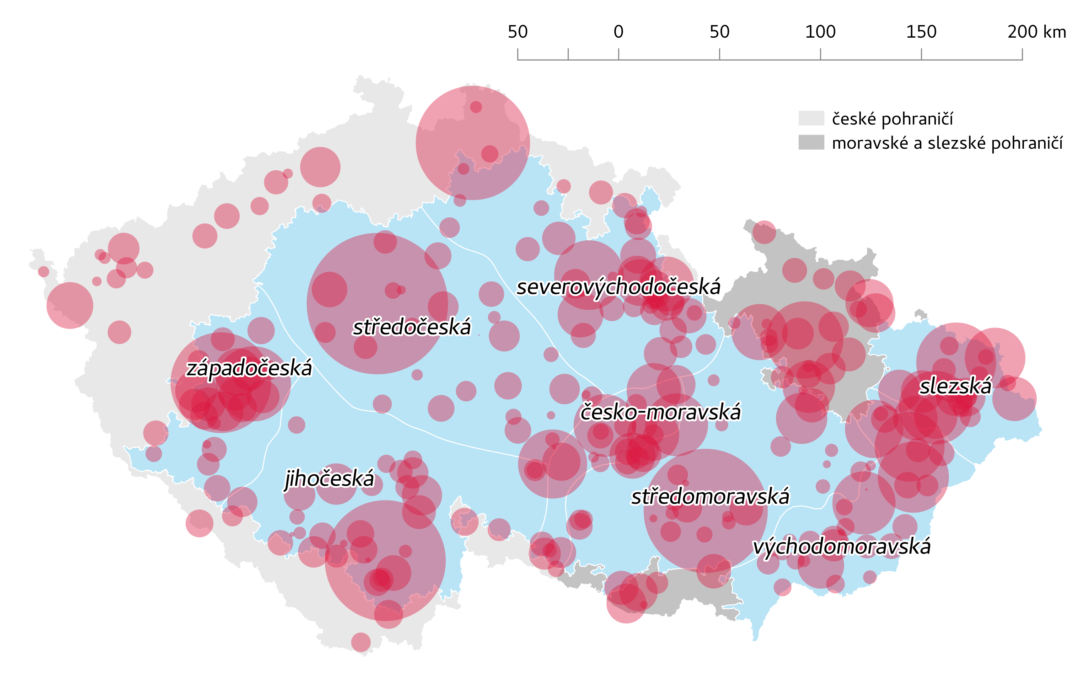
Linear model: Dialogues

Slide 18
Automatic prosody annotation
Tools and approaches

Slide 19
Using prosody for search https://www.korpus.cz/kontext/query?corpname=ortofon_v2

Slide 20
Reminder: Starting point

Slide 21
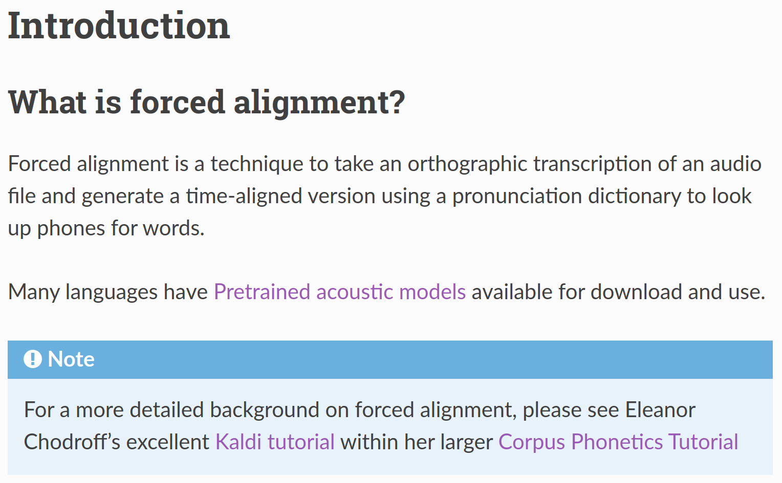
Phone-level alignment with sound: MFA https://montreal-forced-aligner.readthedocs.io

Slide 22
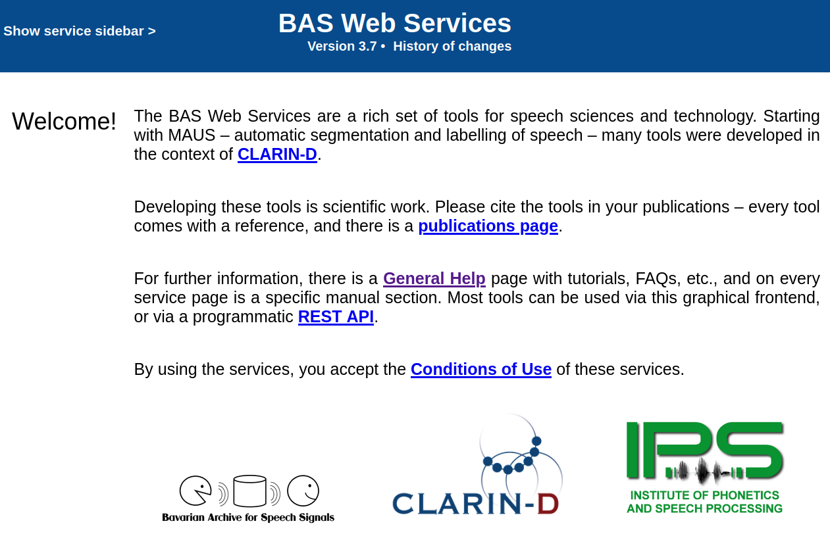
... or BAS Web Services https://clarin.phonetik.uni-muenchen.de/BASWebServices

Slide 23
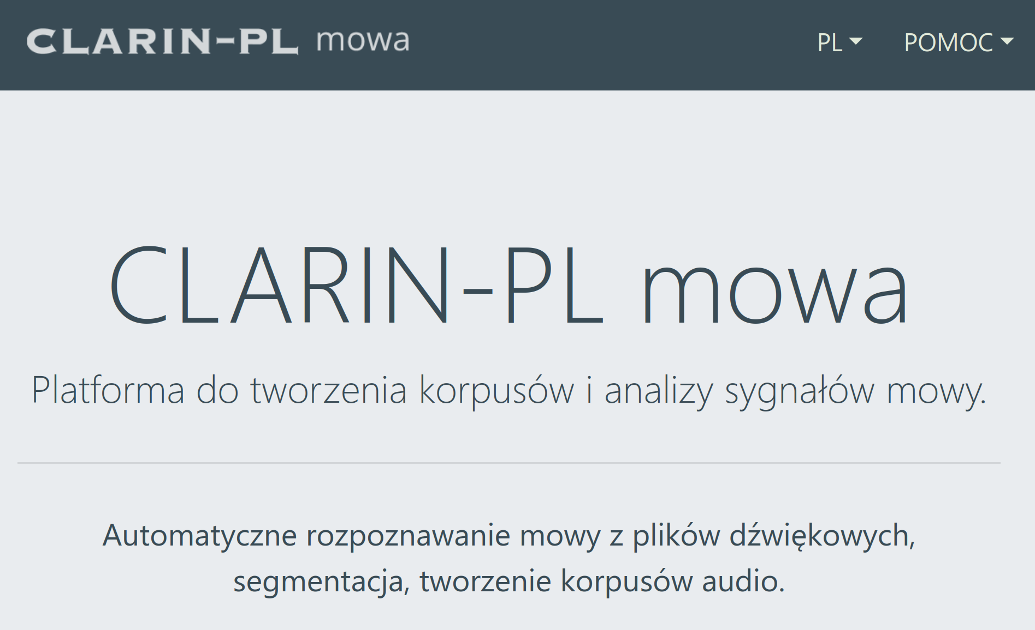
... or CLARIN-PL mowa https://mowa.clarin-pl.eu

Slide 24
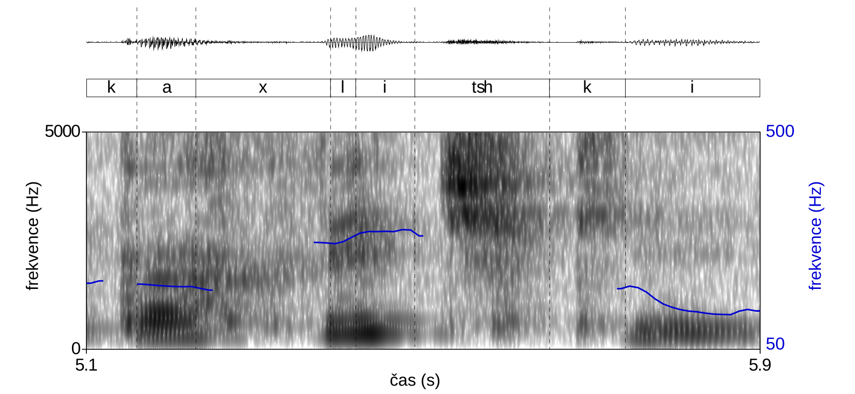
Intonation extraction: Praat https://www.fon.hum.uva.nl/praat

Slide 25
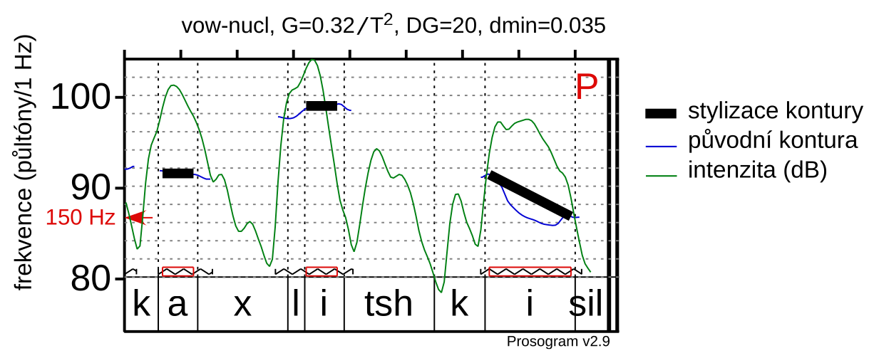
Intonation stylization: Prosogram https://sites.google.com/site/prosogram

Slide 26
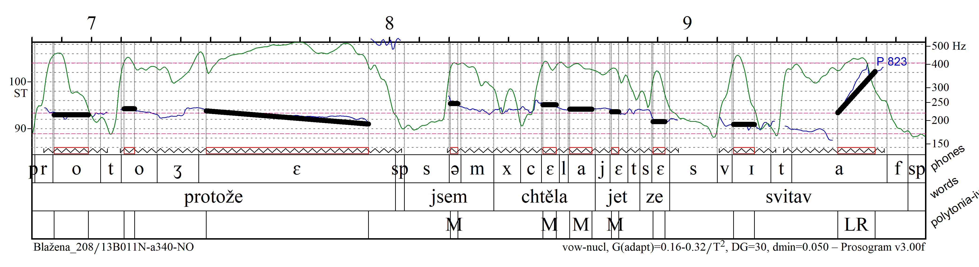
End result

Slide 27
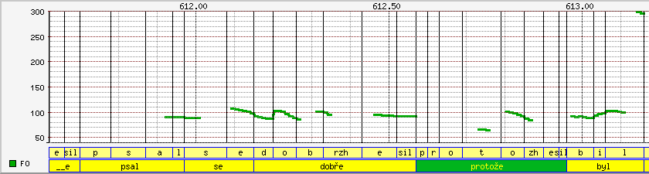
The DIALOG corpus http://ujc.dialogy.cz

Slide 28
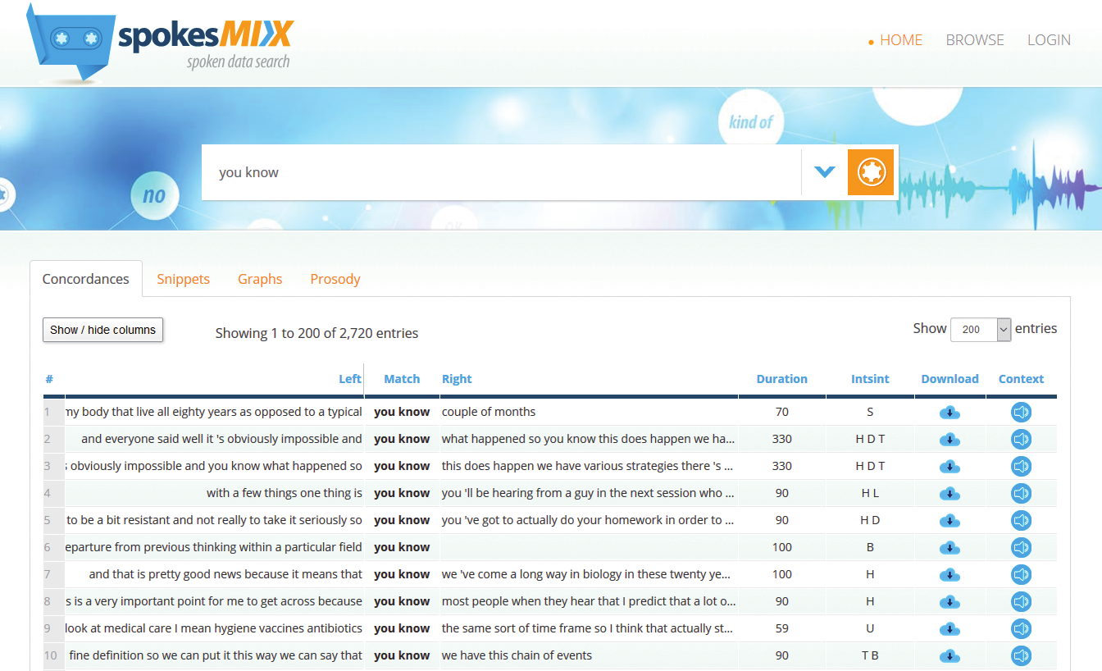
SpokesMIX http://pelcra.clarin-pl.eu/spokes2-web

Slide 29
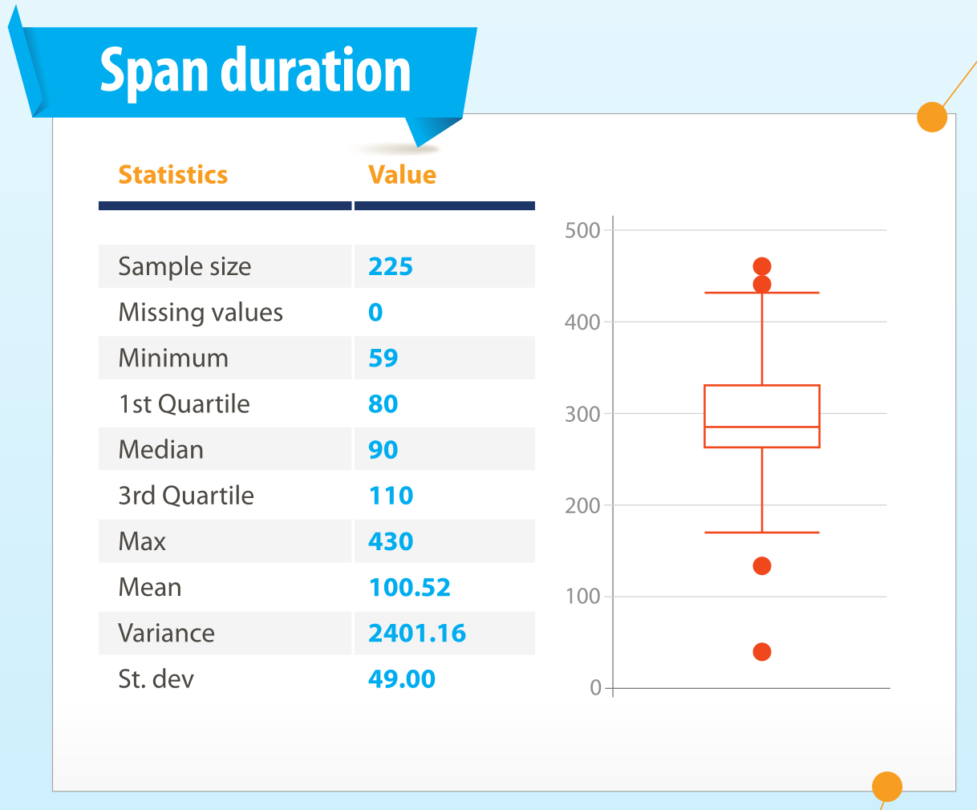
SpokesMIX http://pelcra.clarin-pl.eu/spokes2-web

Slide 30
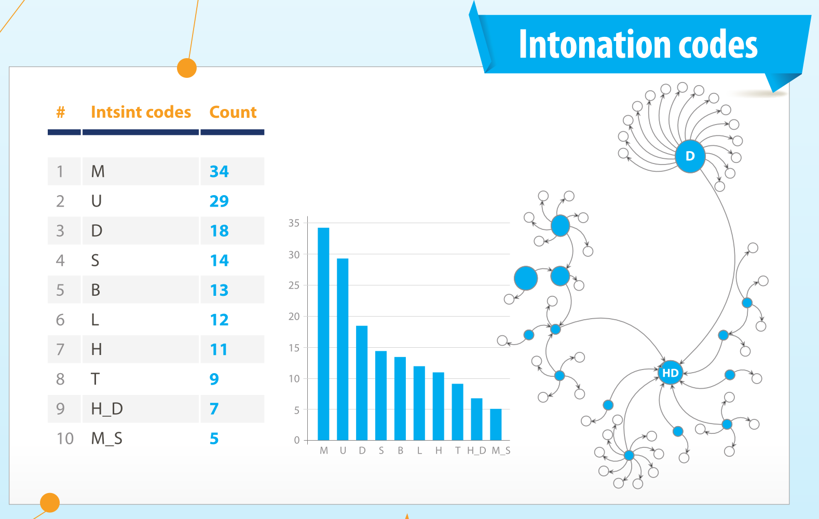
SpokesMIX http://pelcra.clarin-pl.eu/spokes2-web

Slide 31
In summary
visualization
word duration
speech / articulation rate
tonal transcript
pitch range
absolute vs. relative indicators (quantiles)

Slide 32
Literature
Boersma, Paul & David Weenink. 2022. Praat: doing phonetics by computer. https://www.praat.org.
Dolson, Mark. 1994. The Pitch of Speech as a Function of Linguistic Community. Music Perception: An Interdisciplinary Journal. University of California Press 11(3). 321–331.
Komrsková, Zuzana, Marie Kopřivová, David Lukeš, Petra Poukarová & Hana Goláňová. 2017. New Spoken Corpora of Czech: ORTOFON and DIALEKT. Journal of Linguistics/Jazykovedný casopis 68(2). 219–228.
Kopřivová, Marie, Zuzana Laubeová & David Lukeš. 2021. Designing a corpus of Czech monologues: ORATOR v2. Jazykovedný časopis 72(2).
McAuliffe, Michael, Michaela Socolof, Sarah Mihuc, Michael Wagner & Morgan Sonderegger. 2017. Montreal Forced Aligner: Trainable Text-Speech Alignment Using Kaldi. In Interspeech 2017, 498–502. ISCA.
Mertens, Piet. 2004. The Prosogram: Semi-Automatic Transcription of Prosody Based on a Tonal Perception Model. In Proceedings of Speech Prosody 2004, 4. Nara, Japan.
Pęzik, Piotr. 2018. Increasing the Accessibility of Time-Aligned Speech Corpora with Spokes Mix. In Proceedings of LREC 2018, 4297–4300. Miyazaki, Japan: ELRA.
Skarnitzl, Radek. 2018. Fonetická realizace slovního přízvuku u delších slov v češtině. Slovo a slovesnost 79(3). 199–216.
Sloetjes, H. & P. Wittenburg. 2008. Annotation by category—ELAN and ISO DCR. In Proceedings of the 6th International Conference on Language Resources and Evaluation (LREC 2008), 816–820.
Volín, Jan, Kristýna Poesová & Lenka Weingartová. 2015. Speech Melody Properties in English, Czech and Czech English: Reference and Interference. Research in Language 13(1). 107–123.

Slide 33
Acknowledgements
This research was supported by grant nr. 19-21523S from the Grant agency of the Czech Republic (GA ČR): Podíl syntaktických, prozodických a neverbálních prostředků na sekvenčním utváření rozhovorů v češtině.
The corpus data used was collected under the Czech National Corpus project (LM2018137) funded by the Ministry of Education, Youth and Sports of the Czech Republic within the framework of Large Research, Development and Innovation Infrastructures.

